Slide 1
WAEVSR: Enabling collaborative live video super-resolution in wide-area MEC environment
Research Summary & Research Plan
Reporter: Daheng Yin
Affiliation: Southeast University
Email: yindaheng98@seu.edu.cn
Notes:
Good morning professor, may I introduce my current research
Enabling collaborative live video super-resolution in wide-area MEC environment
It is a system research

Slide 2
Notes:
I will introduce the background and challenge of our system,
And next I will introduce our methods and its performance
And finally, I will introduce some further research from this system

Slide 3


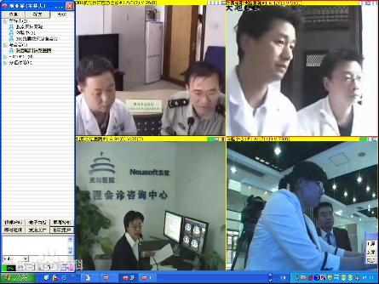
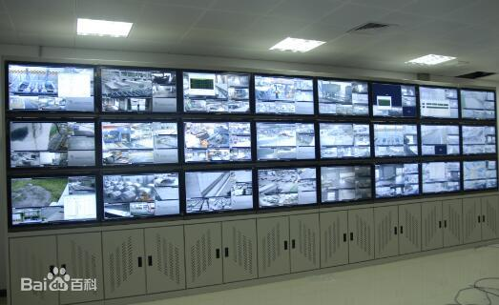

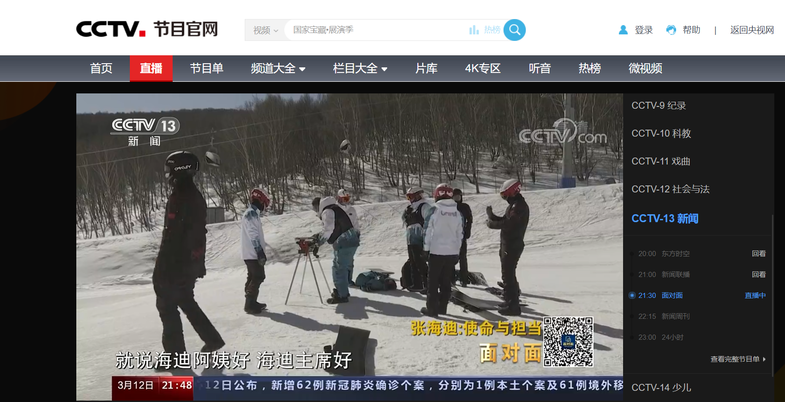
Application of Live Video
Video Conference
Media
Others
Tencent Meeting
Video live
Telehealth
Microsoft Teams
IPTV
Surveillance
Notes:
First is live video
Live video is widely used in many scenarios, including video conference, media, and other such as telehealth and surveillance

Slide 4



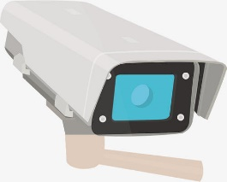

Bottleneck of Live Video
Backbone Network
Single upstream
Cache
Forward
Lots of downstream
Datacenter
Bottleneck at Downstream
Single source
Audiences
Notes:
A common scenario of live video look like this
A single video source up streaming the video into the datacenter
Go through the backbone network
Then datacenter down streaming the video to many audiences
So obviously, the bottleneck is here, the downstream side

Slide 5

Neural-enhanced Live Video (Live Video Super-resolution)
Backbone Network
Single upstream
Cache
Forward
Lots of downstream
Single upstream
Datacenter
Low-resolution Only
Low-resolution
Input
Super-resolution
High-resolution
Output
Super-resolution inference
Audiences
Notes:
To breakthrough this bottleneck, there is what we called neural-enhanced live video or live video super-resolution,
Where deploy a neural network on audiences for super-resolution
So the downstream can send low resolution video only
So that save a lot bandwidth

Slide 6
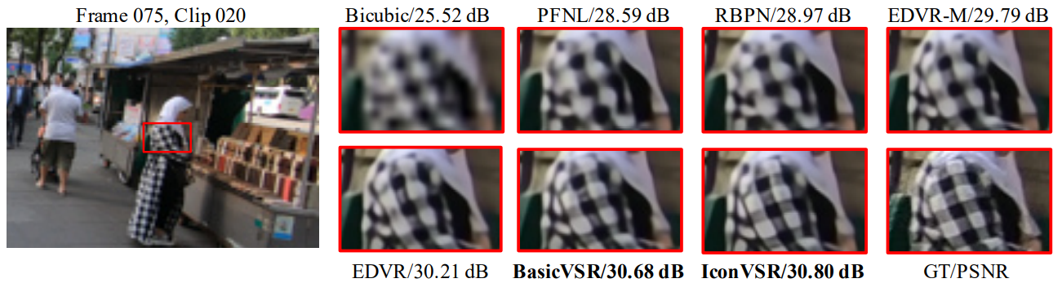
Bottleneck of Neural-enhanced Live Video
What we need
Real-time & High-quality
Where we run it
End-device
Real-time：FPS>30, Latency<500ms
High-quality: accurate Detail restoration
Resource hungry
Resource shortage
Difficult to meet the computational demands
Notes:
However, there is some issues
For live video, we want real-time and high quality
real-time high-quality super-resolution is resource hungry,
But the end-device has limited computational resource

Slide 7

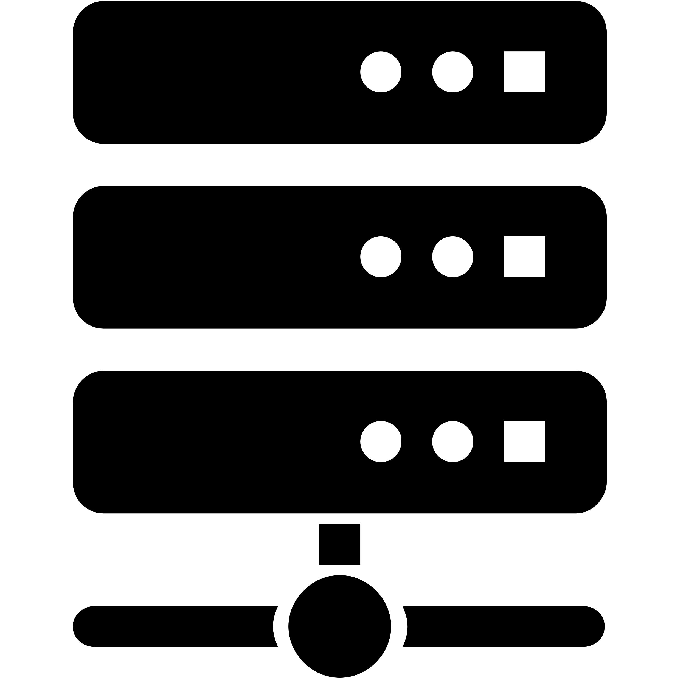
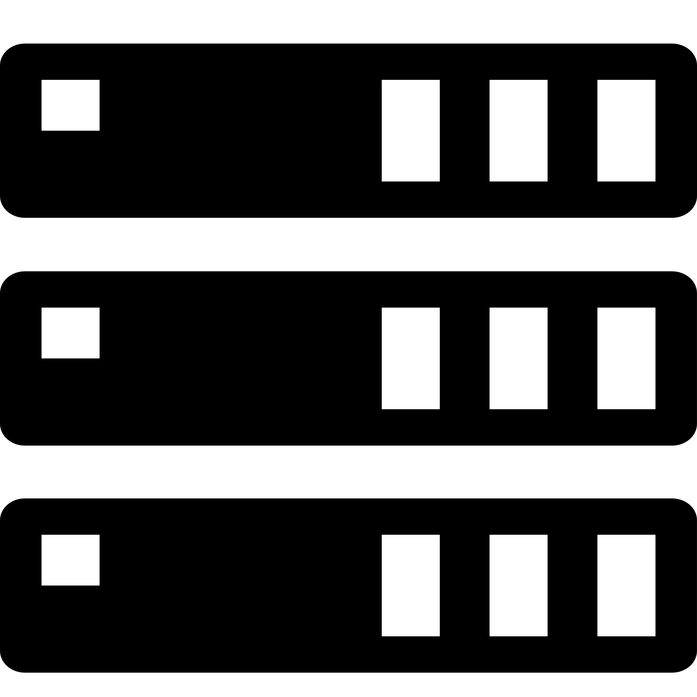




Edge-assist Neural-enhanced Live Video
Downstream low-resolution video
Super-resolution on nearby edge devices
Low resolution Video
Cloud
Wide-area network
Long distance, low bandwidth
Backbone Network
DNN
Edge Devices
High resolution Video
End devices
Downstream high-resolution video
Local network
Short distance, high bandwidth
Notes:
To solve this, there is edge computing, that deploy the neural network on the edge devices
Edge device is more powerful than end-device
And is near end-device, so has a high bandwidth
So we want apply edge computing, like this
where edge device can receive the video, perform inference and send the result to the nearby end devices

Slide 8
Issue: Resource shortage for real-time inference
Super-resolution DNN is large
Single device cannot support real-time inference
Low resolution Video
Cloud
Wide-area network
Long distance, low bandwidth
Backbone Network
DNN
Edge Devices
High resolution Video
End devices
Local network
Short distance, high bandwidth
Notes:
First, edge device is heterogeneous
There is some edge can support real-time high quality
but most of the edge devices cannot support high-quality super-resolution such as BasicVSR or EDVR

Slide 9
Issue: Redundant deployment but produce same content
Redundancy deployment
Low resolution Video
Cloud
Wide-area network
Long distance, low bandwidth
Backbone Network
DNN
Edge Devices
High resolution Video
Produce same content
End devices
Local network
Short distance, high bandwidth
Notes:
Second is the redundancy
Different audience watching same video in different regions
Same model deploy on all this regions but do the same calculation
This is a huge redundancy

Slide 10
Our idea: Collaborative super-resolution
Collaborate
Collaborate
Too large for single edge?
Redundancy deployment?
Inference collaboratively!
(exchange intermediate features)
Divide model into small parts
Notes:
So what we should do is clear, that is, divide a large model into small part
And collaboratively inference
The model part is small, so that can support larger model on weaker devices
The model part is different, so that can reduce redundancy

Slide 11
Our idea: Collaborative super-resolution
Low resolution Video
Cloud
Backbone Network
Deploy
DNN
MEC Devices
High resolution Video
Collaborate
Collaborate
Notes:
In physical graph it would look like this
The edge devices should perform collaboratively inference

Slide 12
Notes:
So here is some challenges

Slide 13
Challenge 1: model division
How to divide model?
Collaborate
Collaborate
Notes:
At first, how to divide model, it is obvious, model division is the first step of collaboration

Slide 14
Challenge 2: latency control
Low resolution Video
Cloud
Backbone Network
DNN
Network is dynamic
MEC Devices
High resolution Video
How to control latency on multiple devices?
Notes:
Second, the network is dynamic, so the latency would be influenced by the bandwidth
So there should be a mechanism for latency control

Slide 15
Challenge 3: frame discontinuity
Difficult to super-resolution frame-by-frame
Use SR-integrated decoder
Merge high-framerate low-resolution and low-framerate high-resolution to high-framerate high-resolution
Scale Compressed Data
High framerate, Low-resolution Frames
(Video from cloud)
Low framerate, High-resolution Frames
Merge
There would be quality decay if no super-resolution frame
How to keep quality?
(Video from super-resolution inference)
High framerate, High-resolution Frames
(Video to audience)
[1] H. Yeo, C. J. Chong, Y. Jung, J. Ye, and D. Han, “NEMO: enabling neural-enhanced video streaming on commodity mobile devices,” in Proceedings of the 26th Annual International Conference on Mobile Computing and Networking, London United Kingdom, Sep. 2020, pp. 1–14.
Notes:
The SR-integrated decoder, that can merge high-framerate low-resolution and low-framerate high-resolution to high-framerate high-resolution
So that we can perform inference only on some of the input frames
But, there is quality decay there, so the problem is, how to keep quality

Slide 16
Notes:
Here is our methods

Slide 17
Our Methods
Parallel-friendly DNN architecture
How to divide model?
Distributed inference controller
How to control latency?
Quality control strategy
How to keep quality?
Notes:
For each challenges, we have a solution

Slide 18
Our Methods
Parallel-friendly DNN architecture
How to divide model?
Distributed inference controller
How to control latency?
Quality control strategy
How to keep quality?
Notes:
First is Parallel-friendly DNN architecture
So why should we invent a Parallel-friendly DNN
That is, the current DNNs are not Parallel-friendly
Here we investigated two exist methods

Slide 19
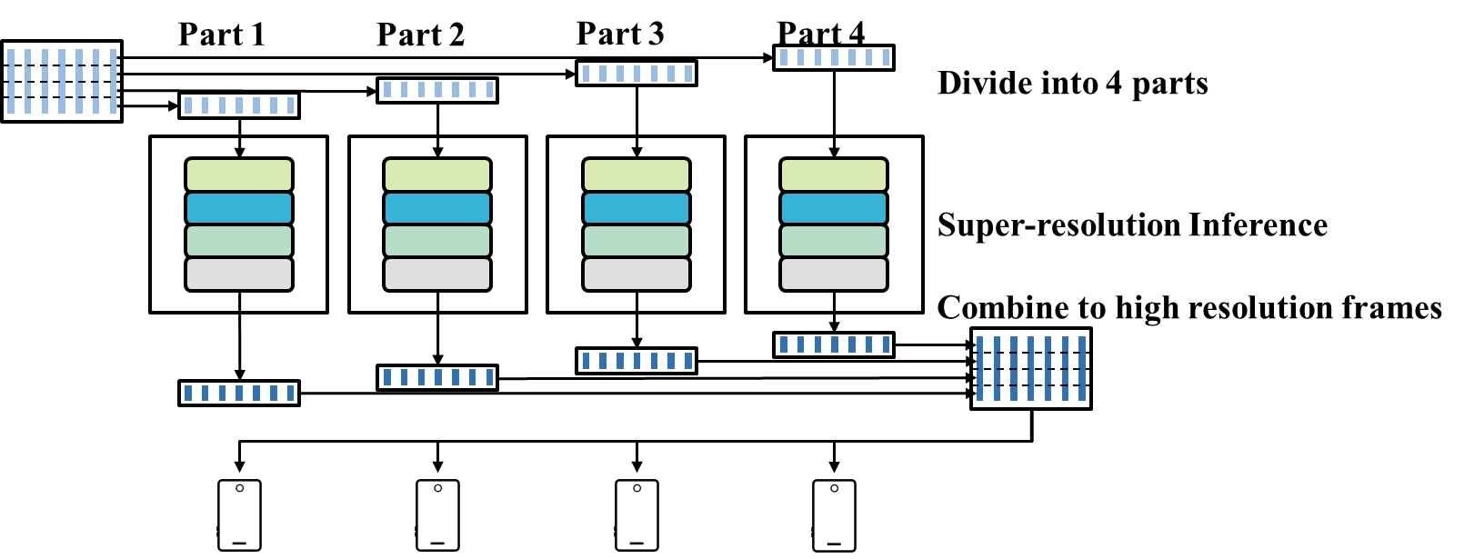
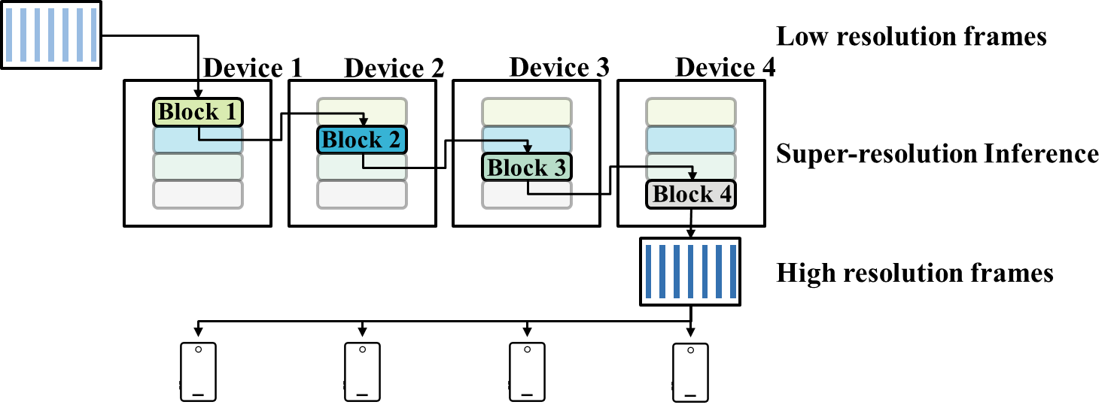
Parallel-friendly DNN architecture: Motivation
Data parallel
How to divide model?
Existing Methods:
Data parallel
Deploy entire model
Inference on small part of data
Model partition
Deploy part of the model
Inference on entire data
Model partition

Slide 20
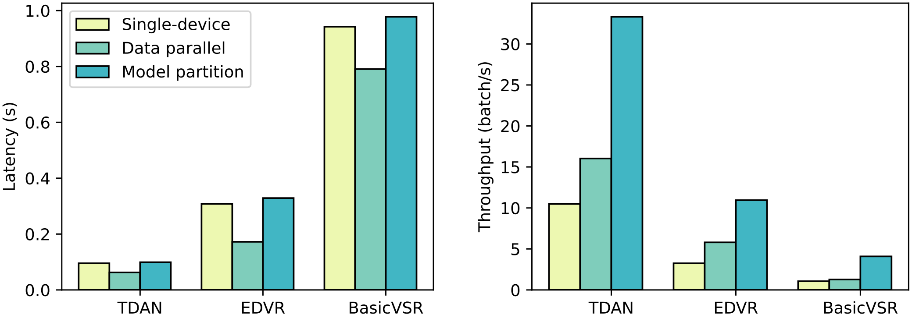
Parallel-friendly DNN architecture: Motivation
Data parallel is not parallel-friendly
Improvement is not significant
Why? Processing live video, batch size is small, cannot fully utilize GPU cores
Notes:
In our experiments, data parallel could not significantly reduce the latency and throughput
The reason is,

Slide 21
Parallel-friendly DNN architecture: Motivation
Data parallel is not parallel-friendly
Improvement is not significant
Why? Processing live video, batch size is small, cannot fully utilize GPU cores
CUDA cores of GPU
Layer 1
Layer 2
Layer 3
Layer 4
Consumed CUDA cores
Already small data size
Reducing data size is not benefit
Large data size
Reducing data size is benefit
Time
Notes:
In live video streaming, data is transferred frame-by-frame
So the batch size is small,
So the model cannot fully utilize GPU cores
Reduce data size is not benefit

Slide 22
Parallel-friendly DNN architecture: Motivation
Model partition is not parallel-friendly
Lower throughput but higher latency
Why? There is data dependency
Notes:
In our experiment, it can improve throughput
But will increase latency

Slide 23
Parallel-friendly DNN architecture: Motivation
Model partition is not parallel-friendly
Lower throughput but higher latency
Why? There is data dependency
Latency here
Low resolution frames
Block 1
Block 2
Super-resolution Inference
Block 3
Block 4
High resolution frames
Notes:
The reason is obvious
Transfer features between layers would cause additional latency

Slide 24
Parallel-friendly DNN architecture: Motivation
What is a ideal collaborate paradigm?
Divide the model rather than data
Few data dependency between model parts
“Parallel-friendly” neural network
Notes:
So what we need?
For short, we need a “Parallel-friendly” neural network
That is, divide the model but has few data dependency

Slide 25
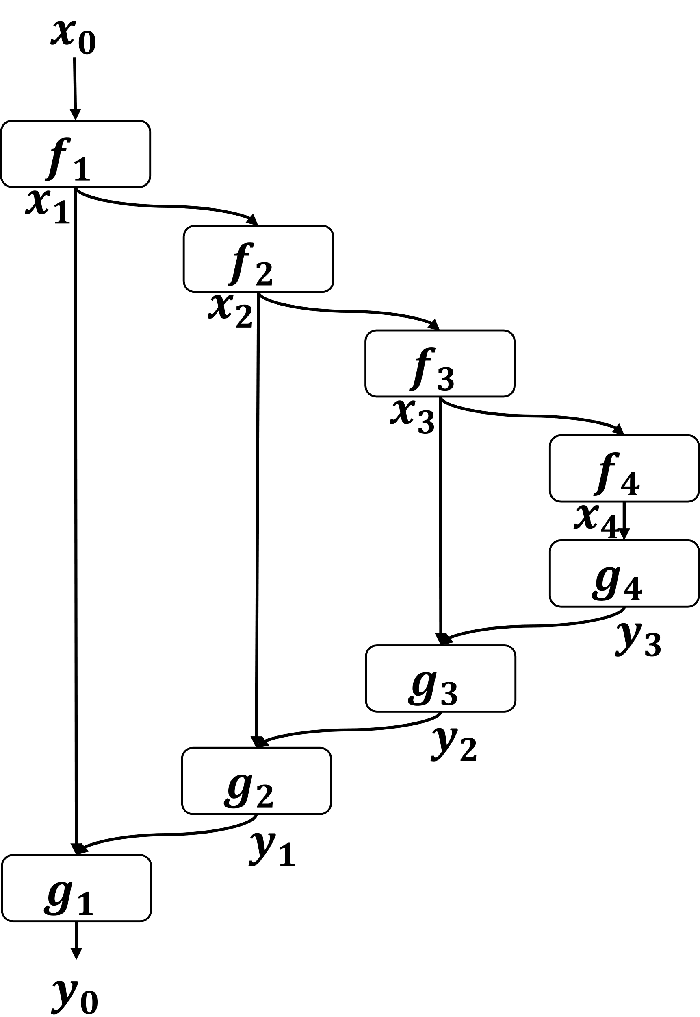
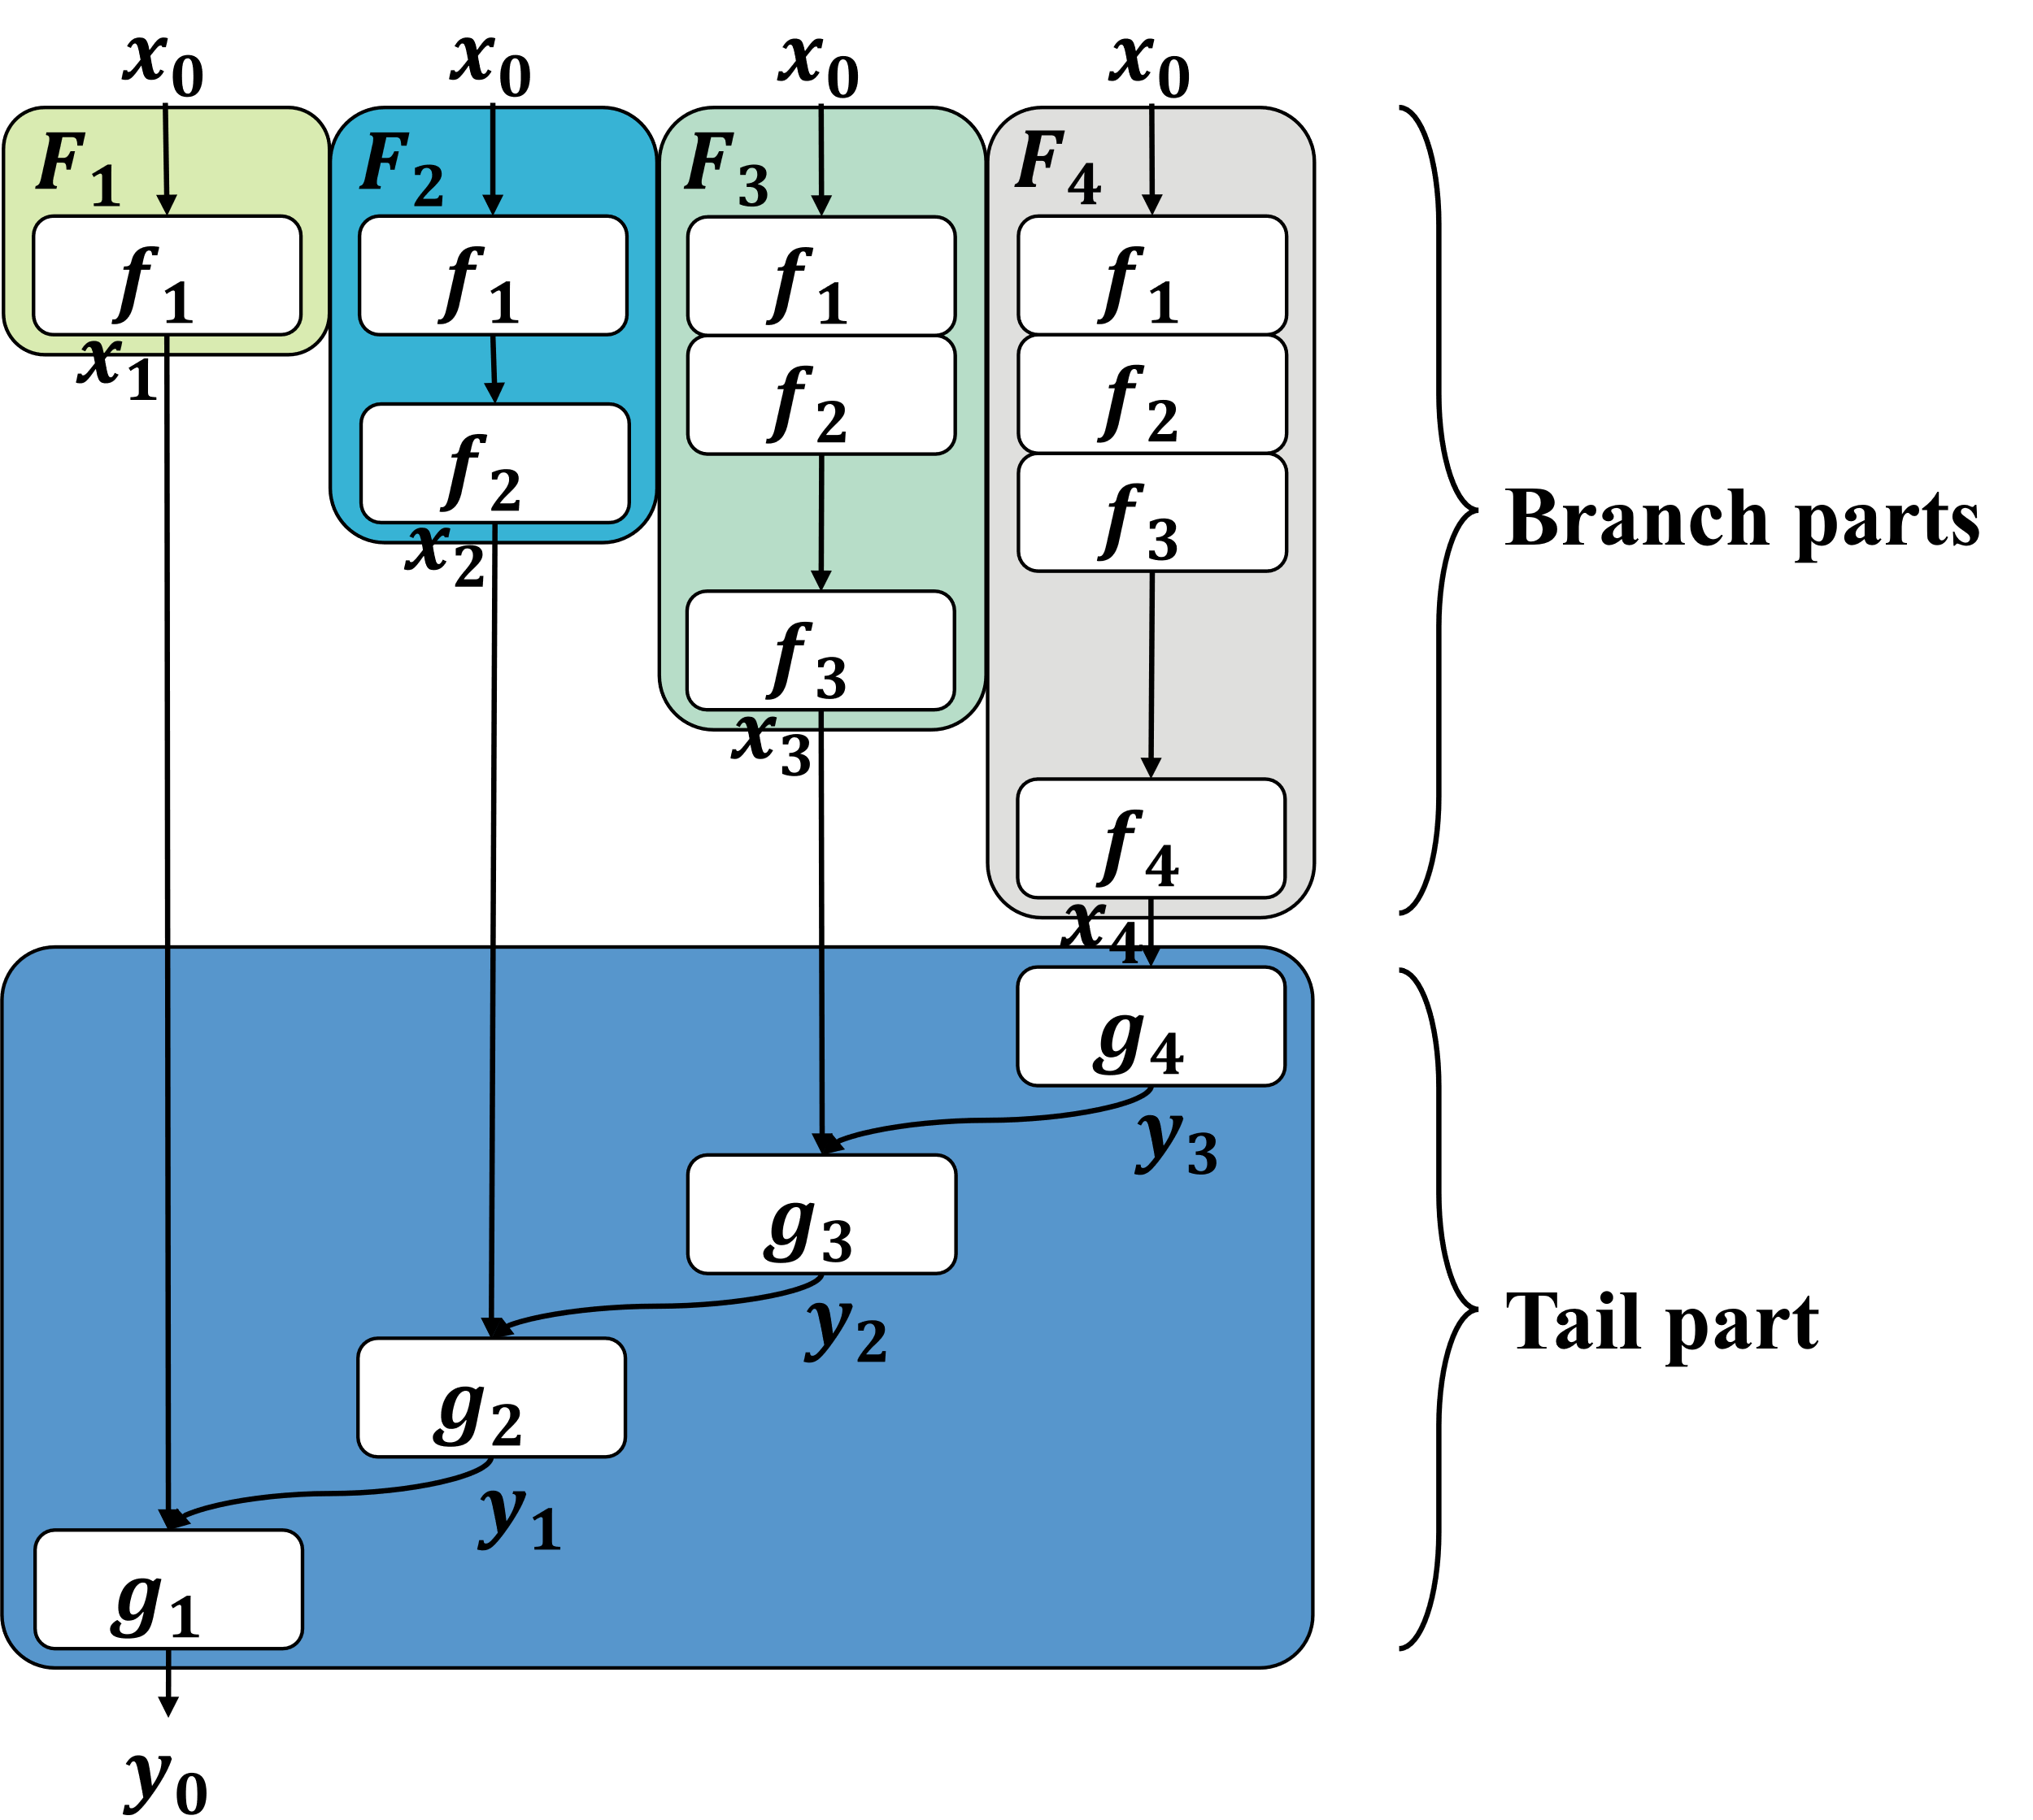
Parallel-friendly DNN architecture: Design
Derived from a widely-used structure: U-net
Step 1: Expand its structure into branches
Expand
Notes:
We found that there is a widely used structure U-net
It is easy to achieve what we want
You see, we can expand the structure into independent branch parts
So the data dependance is only one step

Slide 26
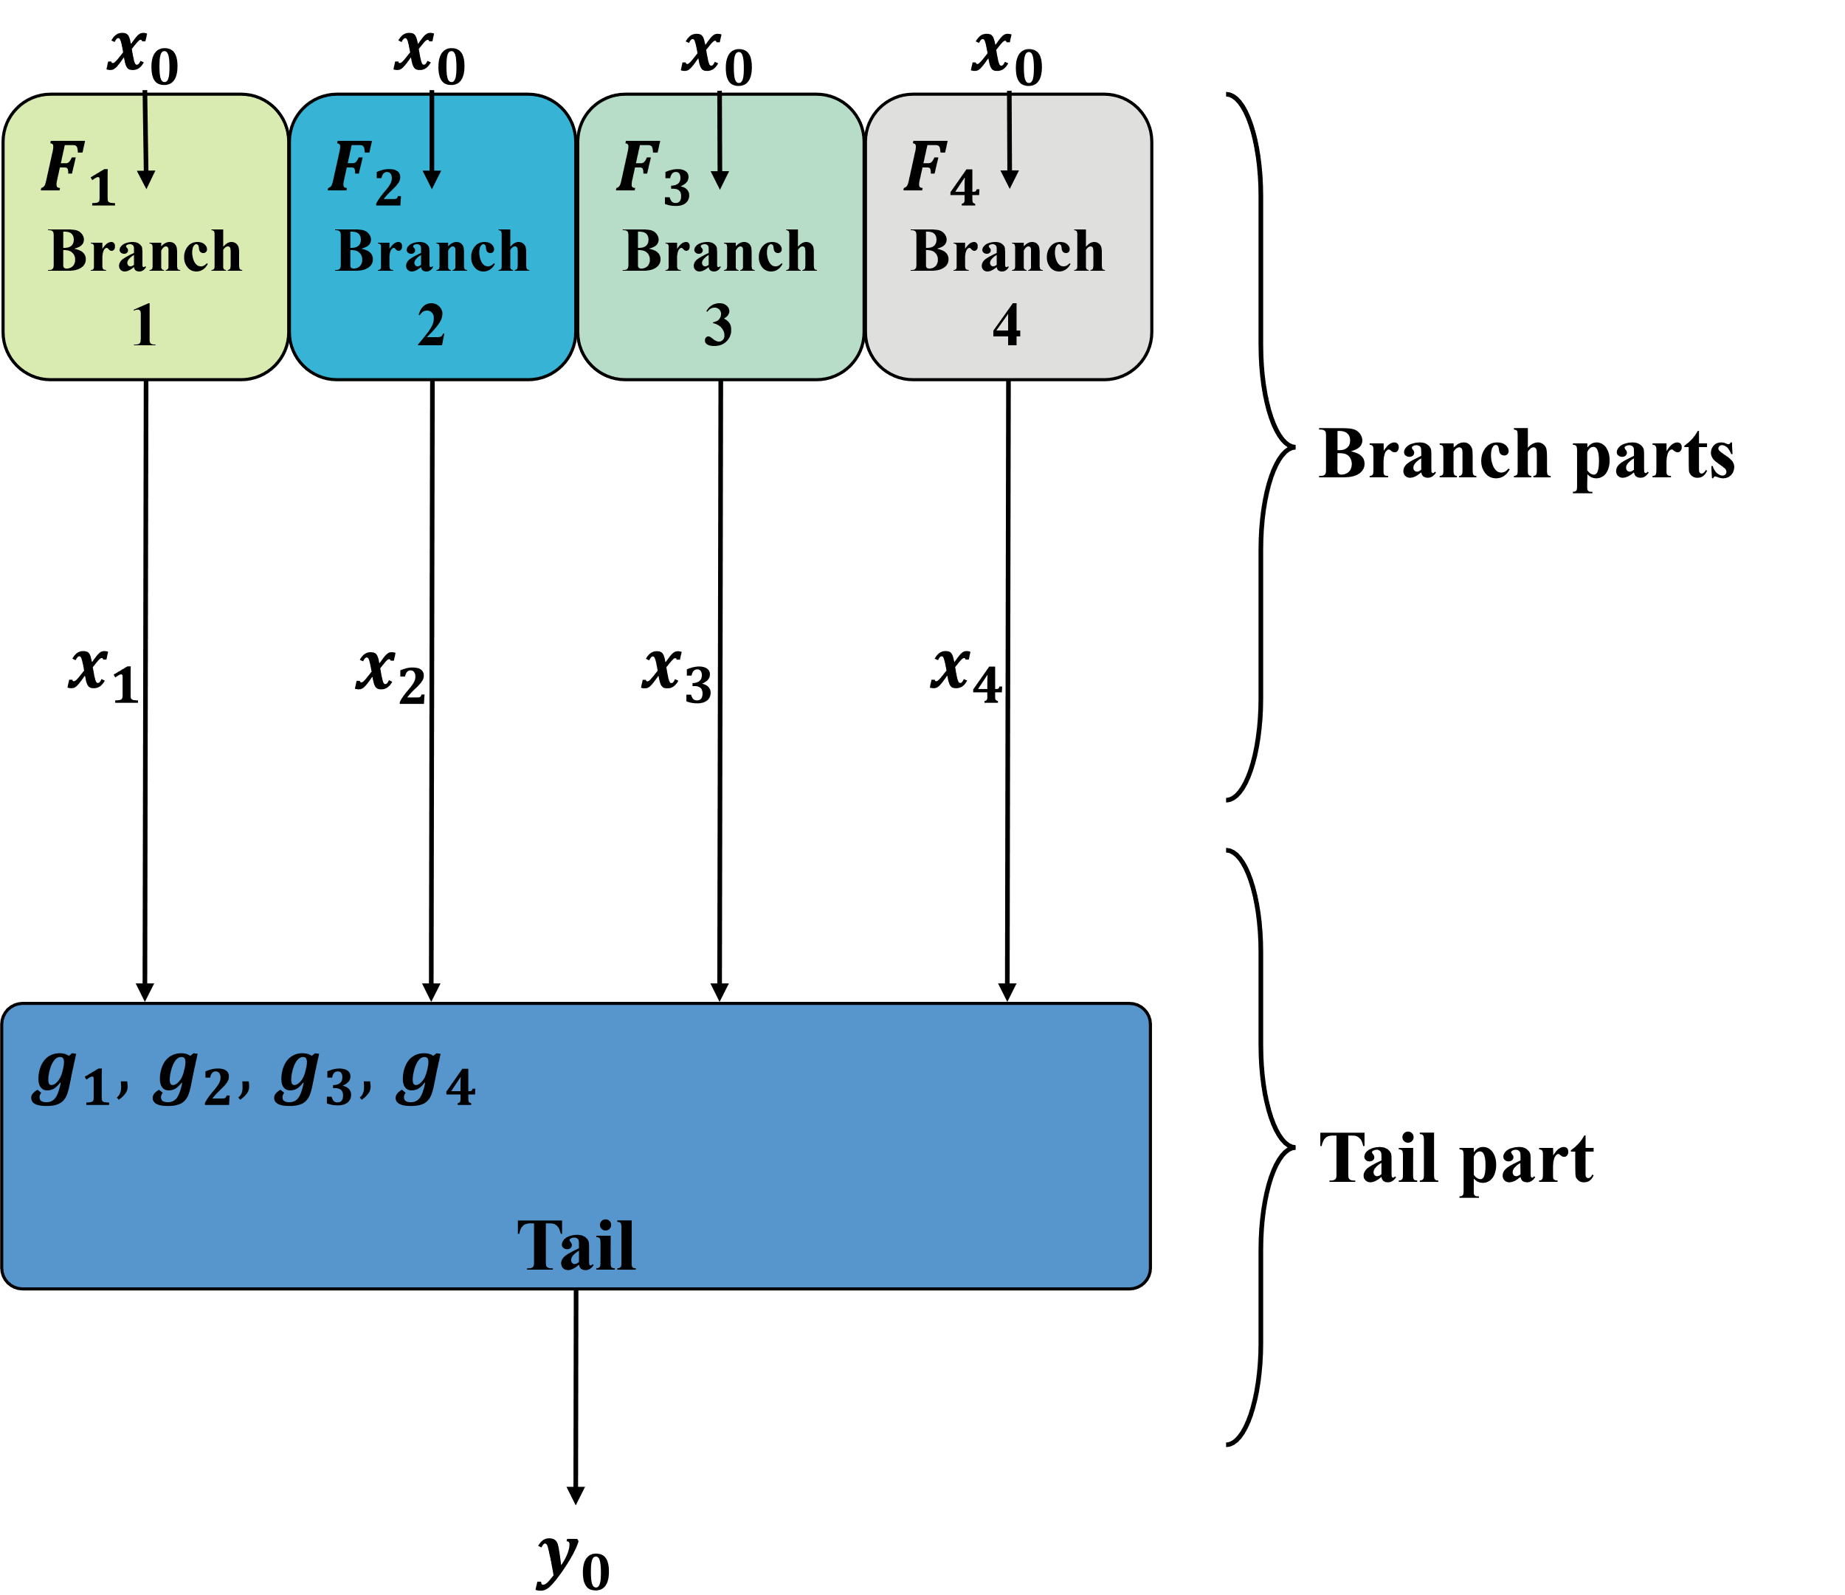
Parallel-friendly DNN architecture: Design
Derived from a widely-used structure: U-net
Step 2: Prune the branch into to reduce redundant
Each branch have same number of layers
Redundant layers
Prune
Notes:
Obviously, there are redundant layers, so we should prune the branch parts for better performance

Slide 27
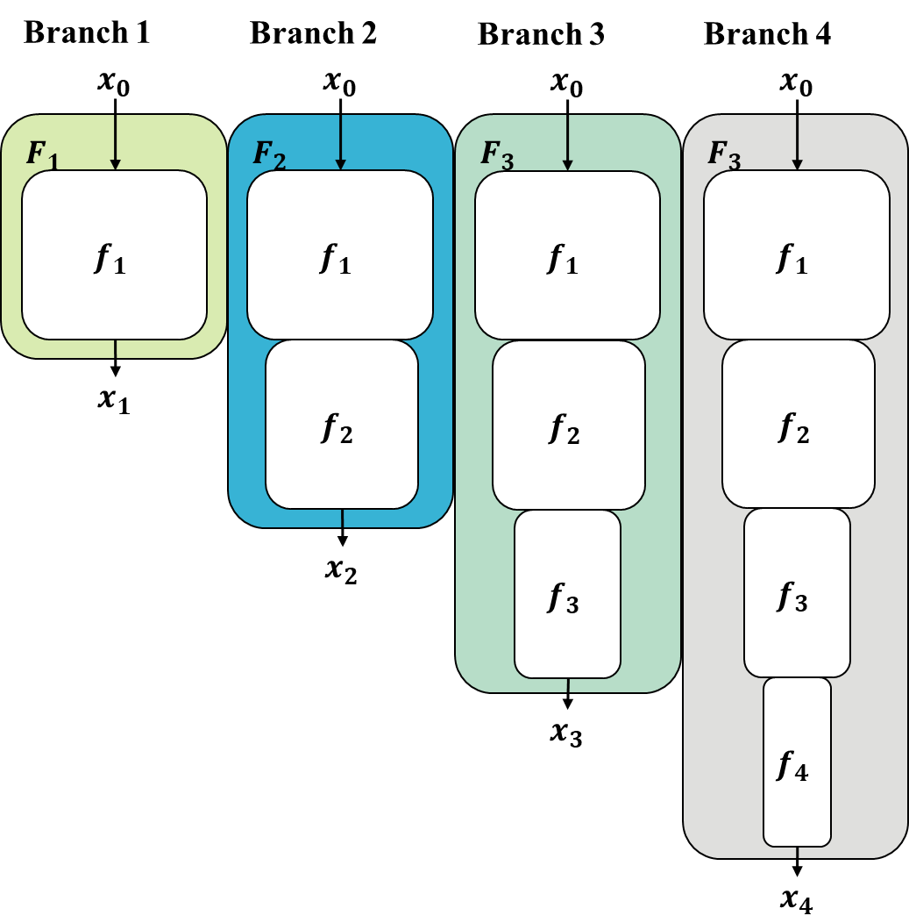
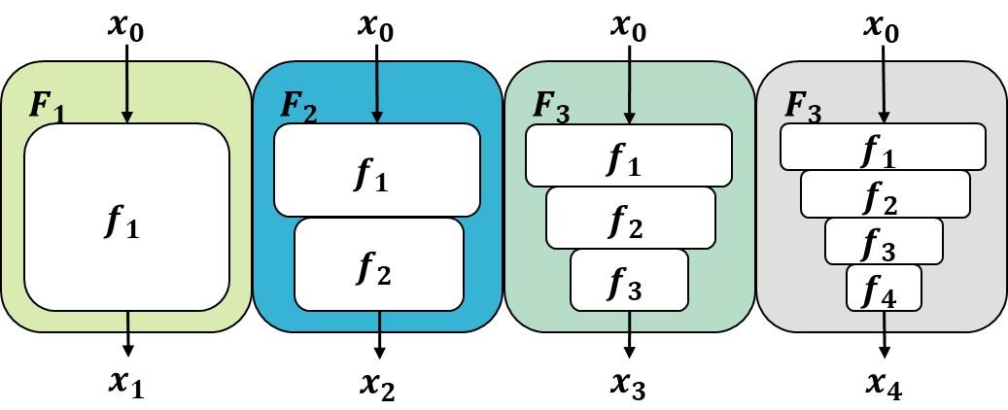
Parallel-friendly DNN architecture: Design
Derived from a widely-used structure: U-net
Step 2: Prune the branch into to reduce redundant
VRTD
Prune
Branches of Expanded VRT[1]
[1] J. Liang et al., “VRT: A Video Restoration Transformer.” arXiv, Jan. 28, 2022.
Notes:
In practice, we use this, VRT, the SOTA model for video super-resolution
It is a typical U-net
We expand this and prune it in two ways
First, replace the downscale block by a downscale layer
Second, reduce the layers in each blocks
So we have two kinds of model
We call them VRTDv2 and VRTDv3

Slide 28
Parallel-friendly DNN architecture: Practical issue
Further prune
Model is huge, only make it parallel-friendly is not enough
Reduce layers
Prune

Slide 29

Parallel-friendly DNN architecture: Practical issue
Feature is huge, impossible to transmit without compression
Compress intermediate features
Reduce channel
Quantize
Compress
480x270 120 channel float64
Linear Layer
480x270 48 channel float64
Quantize
480x270 48 channel int8
Reshape
1920x1080 3 channel int8
…
…
Compressed video (features) stream
Notes:
Here, we also have a practical issue
Since the feature is huge, it must be compressed before transmit in network
We should at least compressed it to like a normal video
So we use some compression technic
We use a linear layer to reduce the channel
And quantize the data from float64 to int8
And pipe it to ffmpeg, and get a compressed video

Slide 30
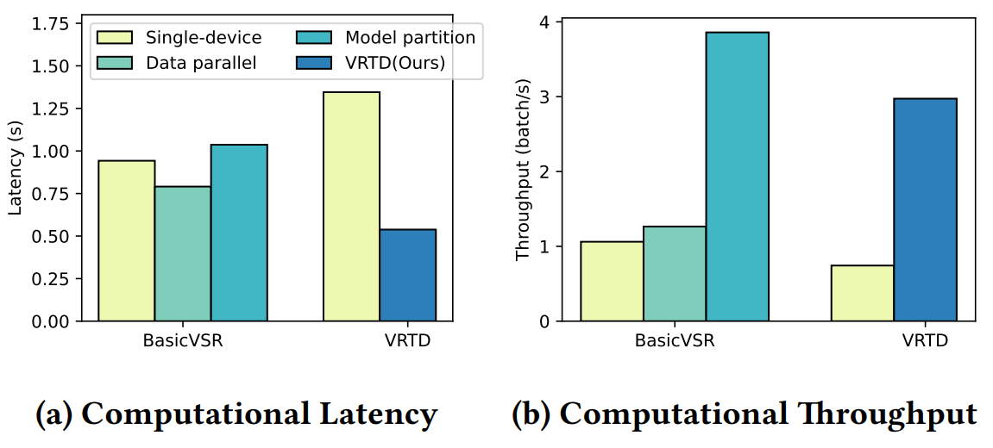
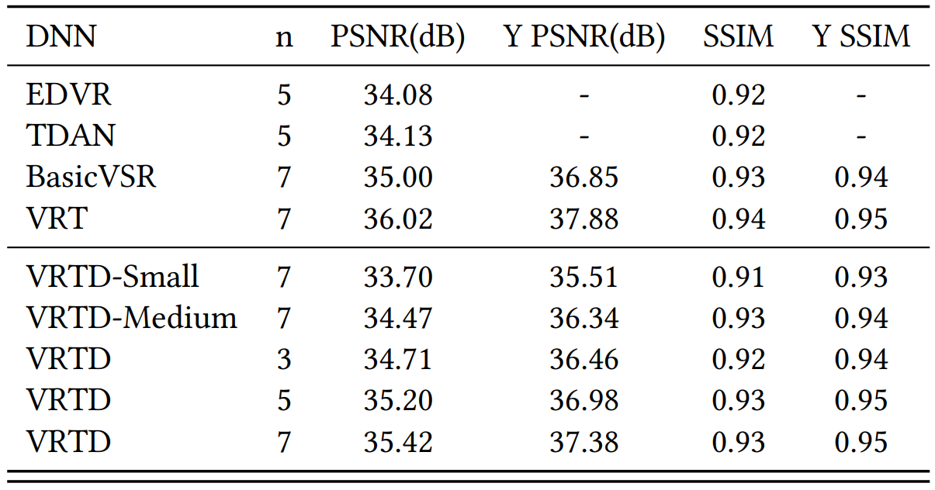
Parallel-friendly DNN architecture: Results
Deploy on 5 GPUs
5x high throughput like data parallel
2.5x low latency
0.6 dB PSNR drop
Notes:
So how is the result?
Our methods achieved a better performance,
But only have a slight drop on quality

Slide 31
Our Methods
Parallel-friendly DNN architecture
How to divide model?
Distributed inference controller
How to control latency?
Quality control strategy
Cannot perform inference frame-by-frame
How to keep quality?
Notes:
Ok now we made a novel model
Next is to control latency
We innovate a Distributed inference controller

Slide 32
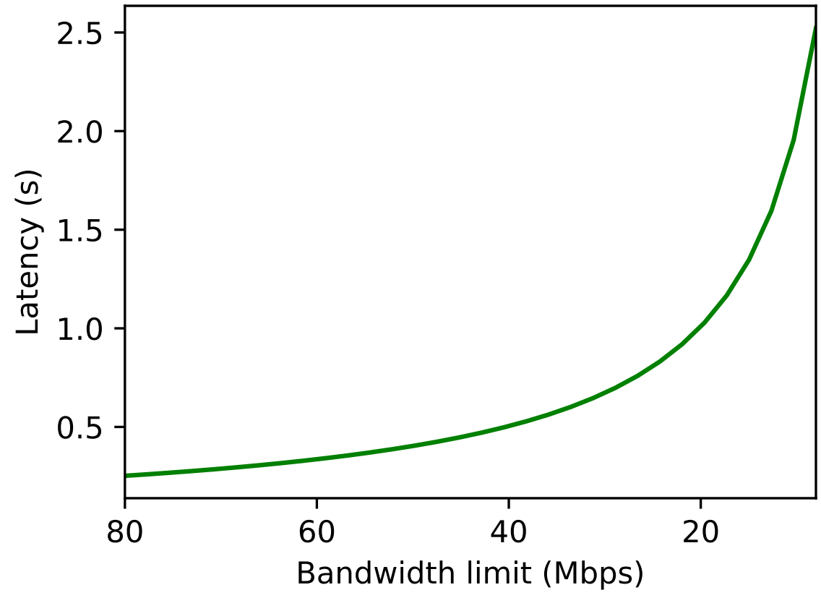
Distributed inference controller: Motivation
How to control latency?
On different devices
Latency
Desired Latency
Notes:
With the DNN structure, the collaboration is undoubtedly the feature transmission
So the latency would be influenced by the bandwidth
The bandwidth is dynamic overtime,
so how can we control the latency?

Slide 33
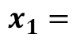
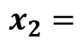
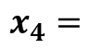
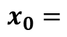
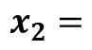
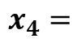
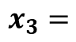
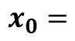
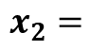
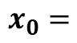
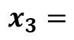
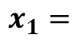
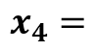
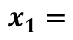
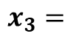
Distributed inference controller: Motivation
How to control latency?
Variable window size (sequence length)
$$x_{0}=$$
$$x_{0}=$$
$$x_{0}=$$
$$x_{1}=$$
$$x_{1}=$$
$$x_{1}=$$
$$x_{2}=$$
$$x_{2}=$$
$$x_{2}=$$
$$x_{3}=$$
$$x_{3}=$$
$$x_{3}=$$
$$x_{4}=$$
$$x_{4}=$$
$$x_{4}=$$
Smaller the input sequence length
Smaller the intermediate feature size
Smaller the latency
Notes:
Through investigation, we found that most VSR model can handle variable sequence length
This property can be used to control quality
Since smaller…

Slide 34
Distributed inference controller: Design
How to control latency?
Variable window size (sequence length)
Time
Window stride
Window size
……
Low-Resolution frames
Branch parts
Send features
Tail part
……
High-resolution frames
Produced by DNN
Produced by SR-integrated decoder

Slide 35
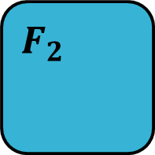
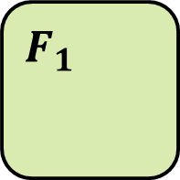
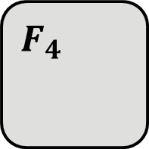
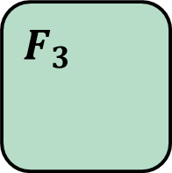
Distributed inference controller: Design
Input synchronization:
Stride (Throughput) synchronization
Window size synchronization
Window stride
Window size
……
Branches should inference on same frames
Device 1
Device 2
Device 3
Device 4
$$F_{1}$$
$$F_{2}$$
$$F_{3}$$
$$F_{4}$$
Branch 1
Branch 2
Branch 3
Branch 4

Slide 36
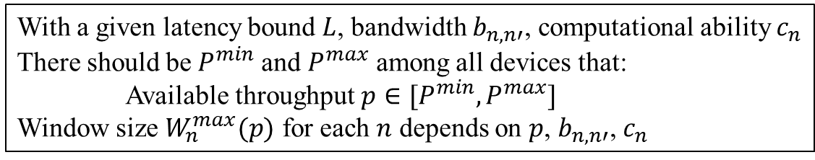
Distributed inference controller: Design
Input synchronization
Stride (Throughput) synchronization
Window size synchronization
Window stride
Window size
……
Device 1
Device 2
Device 3
Device 4
With a given latency bound $L$, bandwidth $b_{n,n′}$, computational ability $c_{n}$
There should be$P^{min}$ and $P^{max}$ among all devices that:
Available throughput $p∈[P^{min},P^{max}]$
Window size $W_{n}^{max}(p)$ for each $n$ depends on $p$, $b_{n,n′}$, $c_{n}$
$$F_{3}$$
$$F_{4}$$
$$F_{1}$$
$$F_{2}$$
Branch 1
Branch 2
Branch 3
Branch 4

Slide 37
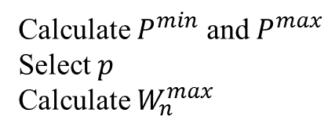
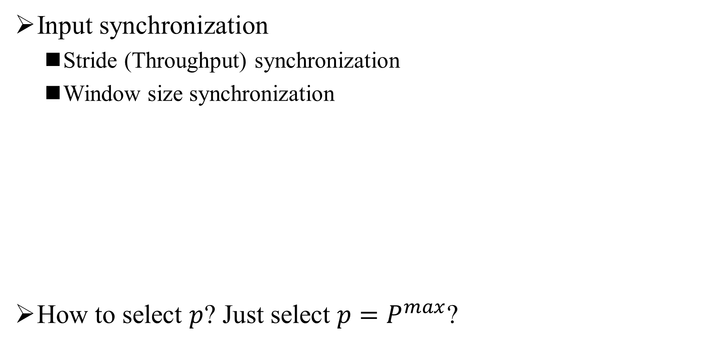
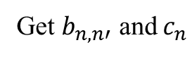
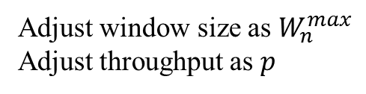
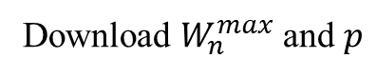
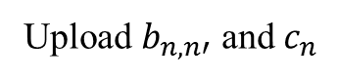
Distributed inference controller: Design
Input synchronization
Stride (Throughput) synchronization
Window size synchronization
How to select $p$? Just select $p=P^{max}$?
Control Unit
Get $b_{n,n′}$ and $c_{n}$
Calculate $P^{min}$ and $P^{max}$
Select $p$
Calculate $W_{n}^{max}$
Custom control strategy
API
Upload $b_{n,n′}$ and $c_{n}$
Download $W_{n}^{max}$ and $p$
With a given latency bound $L$, bandwidth $b_{n,n′}$, computational ability $c_{n}$
There should be$P^{min}$ and $P^{max}$ among all devices that:
Available throughput $p∈[P^{min},P^{max}]$
Window size $W_{n}^{max}(p)$ for each $n$ depends on $p$, $b_{n,n′}$, $c_{n}$
Execution
Unit
Execution
Unit
Execution
Unit
Adjust window size as $W_{n}^{max}$
Adjust throughput as $p$
Notes:
But how to select the throughput?
Perhaps, there is no benchmark for us to choose
The selection strategy is in next

Slide 38
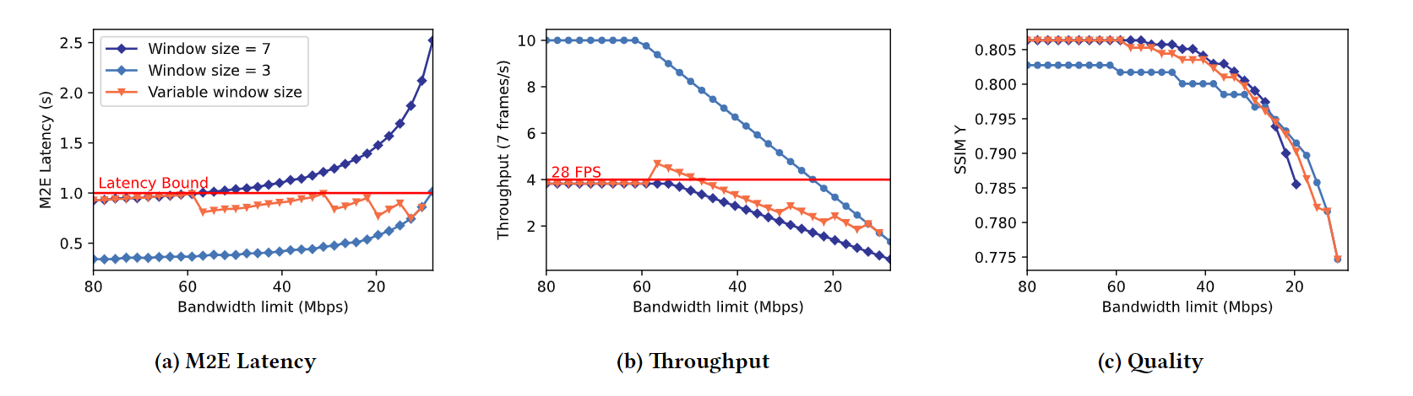
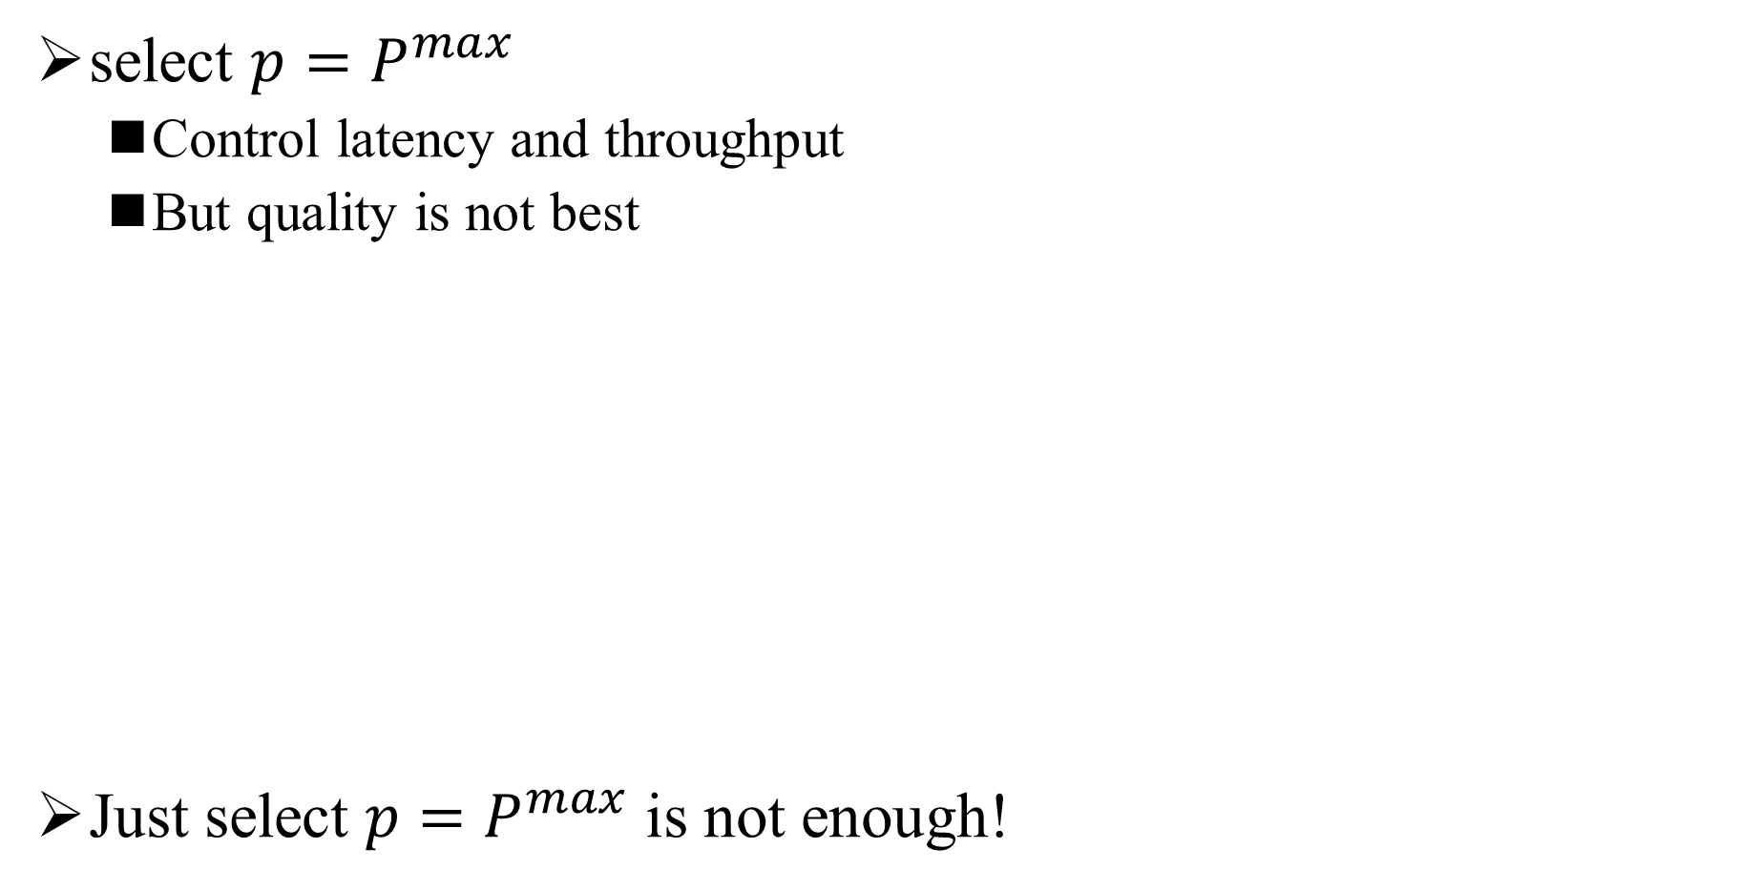
Distributed inference controller: Result
select $p=P^{max}$
Control latency and throughput
But quality is not best
Just select $p=P^{max}$ is not enough!
Control latency
Quality NOT best
Control throughput
Notes:
See this orange line

Slide 39
Our Methods
Parallel-friendly DNN architecture
How to divide model?
Distributed inference controller
How to control latency?
Quality control strategy
How to keep quality?

Slide 40
Quality control strategy: Motivation
Why not perform inference frame-by-frame?
Frame-by-frame inference is resource hungry
How to handle frame discontinuity?
SR-integrated video decoder
Scale Compressed Data
High framerate, Low-resolution Frames
Low framerate, High-resolution Frames
Merge
High framerate, High-resolution Frames
[1] H. Yeo, C. J. Chong, Y. Jung, J. Ye, and D. Han, “NEMO: enabling neural-enhanced video streaming on commodity mobile devices,” in Proceedings of the 26th Annual International Conference on Mobile Computing and Networking, London United Kingdom, Sep. 2020, pp. 1–14.

Slide 41
Quality control strategy: Design
How to use SR-integrated video decoder?
Time
Window stride
Window size
……
Inference on some frames
……
Merge on end-device
Produced by DNN
Produced by SR-integrated decoder

Slide 42
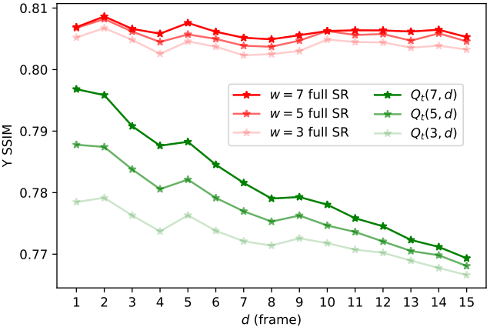
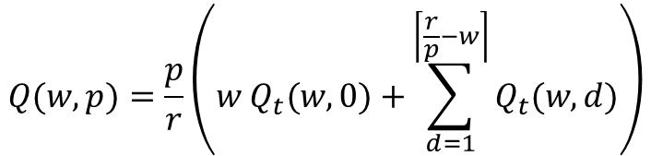
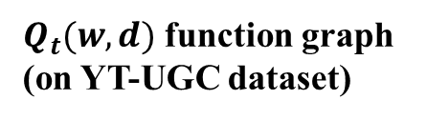
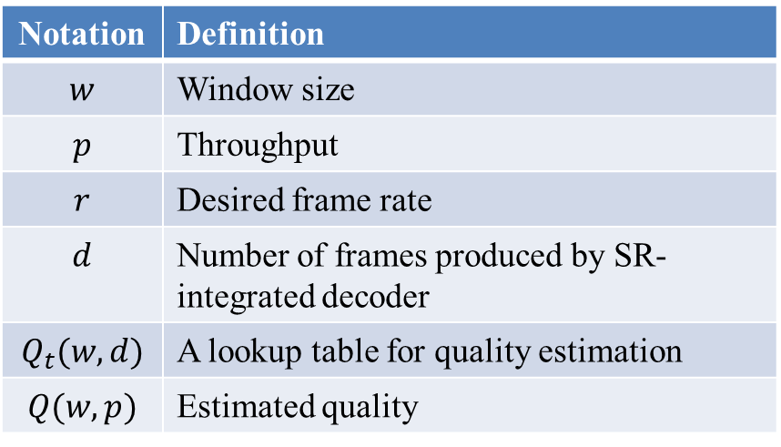
Quality control strategy: Design
How is the output quality?
Quality statistics on 150 1080p video clips
$Q_{t}(w, d)$ function graph (on YT-UGC dataset)
$$Q(w, p)=\frac{p}{r}\left(w Q_{t}(w, 0)+\sum_{d=1}^{\left\lceil \frac{r}{p}−w\right\rceil }{Q_{t}(w, d)}\right)$$
Notation | Definition
$$w$$ | Window size
$$p$$ | Throughput
$$r$$ | Desired frame rate
$$d$$ | Number of frames produced by SR-integrated decoder
$$Q_{t}(w, d)$$ | A lookup table for quality estimation
$$Q(w, p)$$ | Estimated quality

Slide 43

Quality control strategy: Design
How to select 𝑝?
Select by best quality!
Control Unit
Get $b_{n,n′}$ and $c_{n}$
Calculate $P^{min}$ and $P^{max}$
Select $p$
Calculate $W_{n}^{max}$
Custom control strategy
API
$$\begin{matrix}\max_{p} & Q(w,p) \\ s.t. & w=\min_{n}⁡(W_{n}^{max}(p)) \\ & p∈[P^{min},P^{max}]\end{matrix}$$
Upload $b_{n,n′}$ and $c_{n}$
Download $W_{n}^{max}$ and $p$
Execution
Unit
Execution
Unit
Execution
Unit
Adjust window size as $W_{n}^{max}$
Adjust throughput as $p$

Slide 44


Quality control strategy: Result
Better quality:
Best quality

Slide 46
Further Research Plan
Insight into the stability of the super-resolution model
Correlation between compressed video and super-resolution
How VSR model leverage inter-frame features
How VSR model extract multi-scale features

Slide 47

Insight into the stability of the super-resolution model
What impress me
super-resolution models maybe more stable
Model | Seq length | PSNR | Y PSNR | SSIM | Y SSIM
Bicubic |  | 29.79 | 31.32 | 0.8483 | 0.8684
EDVR | 7 | 34.08 |  | 0.9216
TDAN | 5 | 34.13 |  | 0.9240
BasicVSR | 7 | 35.00 | 36.85 | 0.9292 | 0.9415
VRT | 3 | 35.37 | 37.16 | 0.9329 | 0.9450
VRT | 7 | 36.04 | 37.87 | 0.9399 | 0.9514
VRTDv2 | 7 | 35.42 | 37.37 | 0.9344 | 0.9477
VRTDv2 Quantized | 7 | 35.34 | 37.28 | 0.9336 | 0.9469
VRTDv3 | 7 | 35.35 | 37.34 | 0.9345 | 0.9476
VRTDv3 Quantized | 7 | 35.39 | 37.37 | 0.9342 | 0.9474
Quality drop slightly with simple compression and quantization
Features were compressed and quantized, but quality still better than BasicVSR
Notes:
For the stability,
the things that impress is,
the quality drop is not much even the feature compressed from 120 to 48 and quantized from float64 to int8

Slide 48
Insight into the stability of the super-resolution model
Further Research
Save bandwidth
Reduce computation
480x270 120 channel float64
How the number of channels here correlates with quality?
Linear Layer
(Reduce computation) How small can the model be compressed to?
480x270 48 channel float64
Quantize
How the number of channels here correlates with quality?
480x270 48 channel int8
Reshape
1920x1080 3 channel int8
How lossy compression affects quality?
(Save bandwidth) How small can the features be compressed to?
…
…
Compressed video (features) stream
Notes:
So the further research will still around the bandwidth saving and computation.
For bandwidth saving, we can try some more aggressive compression strategy,
Including here, further reduce the channel
Or here, using lossy compression

Slide 49
Insight into the stability of the super-resolution model
Further Research
Understand the foundation of stability
Is super-resolution model more stable than other types of models? Why?
Understand the stability on feature compression
Where is the limit of feature compression? What cause the limit?
Related Works
[1] H. Choi and I. V. Bajić, “Near-Lossless Deep Feature Compression for Collaborative Intelligence,” in 2018 IEEE 20th International Workshop on Multimedia Signal Processing (MMSP), 2018, pp. 1–6. doi: 10.1109/MMSP.2018.8547134.
[2] A. E. Eshratifar, A. Esmaili, and M. Pedram, “BottleNet: A Deep Learning Architecture for Intelligent Mobile Cloud Computing Services,” in 2019 IEEE/ACM International Symposium on Low Power Electronics and Design (ISLPED), Jul. 2019, pp. 1–6. doi: 10.1109/ISLPED.2019.8824955.
[3] A. Ilyas, S. Santurkar, D. Tsipras, L. Engstrom, B. Tran, and A. Madry, “Adversarial Examples Are Not Bugs, They Are Features,” in Advances in Neural Information Processing Systems, 2019, vol. 32. Accessed: Oct. 17, 2022.
……

Slide 50


Correlation between compressed video and super-resolution
What impress me
Correlation between PSNR and packet size
Vimeo90k
REDS
Packet Size
PSNR (BasicVSR)

Slide 51


Correlation between compressed video and super-resolution
What impress me
Correlation between PSNR and packet size
Packet Size
PSNR(SR-integrator decoder)
Dataset: Youtube UGC

Slide 52

Correlation between compressed video and super-resolution
Further Research
Improve quality
Increase the accuracy of video quality predictions
by access the content of the compressed video

Slide 53


Correlation between compressed video and super-resolution
Further Research
How can video encoder benefit video process?
(not only super-resolution)
Related Works
[1] Y. Huo et al., “Compressed Video Contrastive Learning,” in Advances in Neural Information Processing Systems, 2021, vol. 34, pp. 14176–14187. Accessed: Oct. 15, 2022.
[2] P. Chen, W. Yang, M. Wang, L. Sun, K. Hu, and S. Wang, “Compressed Domain Deep Video Super-Resolution,” IEEE Transactions on Image Processing, vol. 30, pp. 7156–7169, 2021, doi: 10.1109/TIP.2021.3101826.

